Slide 1
CS2100
Tutorial #8
MSI Components
(Prepared by: Aaron Tan)

Slide 2
Q1.
F(X,Y,Z) = Π M(1,5,6) ∙ D(4)
X | Y | Z | F
0 | 0 | 0
0 | 0 | 1
0 | 1 | 0
0 | 1 | 1
1 | 0 | 0
1 | 0 | 1
1 | 1 | 0
1 | 1 | 1
1
0
1
1
d
Using d instead of X for don’t care to avoid confusion with input X.
0
0
1

Slide 3
Q1.
F(X,Y,Z) = Π M(1,5,6) ∙ D(4)
X | Y | Z | F
0 | 0 | 0 | 1
0 | 0 | 1 | 0
0 | 1 | 0 | 1
0 | 1 | 1 | 1
1 | 0 | 0 | d
1 | 0 | 1 | 0
1 | 1 | 0 | 0
1 | 1 | 1 | 1
1
0
1
1
d
0
0
1
0
1
2
3
4
5
6
7
8:1
MUX
F
0
1
2
Z
Y
X

Slide 4
Q1.
F(X,Y,Z) = Π M(1,5,6) ∙ D(4)
X | Y | Z | F | F
0 | 0 | 0 | 1
0 | 0 | 1 | 0
0 | 1 | 0 | 1
0 | 1 | 1 | 1
1 | 0 | 0 | d
1 | 0 | 1 | 0
1 | 1 | 0 | 0
1 | 1 | 1 | 1
Z’
Z'
1
0
Z
0
1
2
3
4:1
MUX
1
F
0
0 or
Z'
1
Y
X
Z

Slide 5
Q2.
K(W,X,Y,Z) = Σ m(8,11)
Cin
Cin
2×4
DEC
2×4
DEC
W
X
S₁
0
1
2
3
Y
Z
S₁
0
1
2
3
K
S₀
S₀
E
E
1
Cin
2×4
DEC
S₁
0
1
2
3
S₀
E

Slide 6
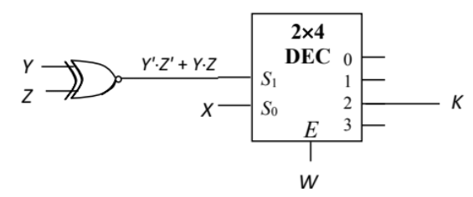
Q2.
K(W,X,Y,Z) = Σ m(8,11)
Cin
Cin
2×4
DEC
2×4
DEC
W
X
S₁
0
1
2
3
Y
Z
S₁
0
1
2
3
K
S₀
S₀
E
E
1

Slide 7

Q3.
What is your observation?
A | B | C | D | F | G | H
0 | 0 | 0 | 0 | 0 | 0 | 0
1 | 0 | 0 | 0 | 0 | 0 | 1
1 | 1 | 0 | 0 | 0 | 1 | 0
1 | 1 | 1 | 0 | 0 | 1 | 1
1 | 1 | 1 | 1 | 1 | 0 | 0
0 | 1 | 1 | 1 | 1 | 0 | 1
0 | 0 | 1 | 1 | 1 | 1 | 0
0 | 0 | 0 | 1 | 1 | 1 | 1

Slide 8
A | B | C | D | F | G | H
0 | 0 | 0 | 0 | 0 | 0 | 0
1 | 0 | 0 | 0 | 0 | 0 | 1
1 | 1 | 0 | 0 | 0 | 1 | 0
1 | 1 | 1 | 0 | 0 | 1 | 1
1 | 1 | 1 | 1 | 1 | 0 | 0
0 | 1 | 1 | 1 | 1 | 0 | 1
0 | 0 | 1 | 1 | 1 | 1 | 0
0 | 0 | 0 | 1 | 1 | 1 | 1
Ideas:
If A=1 (or D=0), count #1s in ABCD.
If A=0 (or D=1), #1s + 2 × #0s.
Q3.
Cin
4-bit
// adder
X₃
X₂
X₁
X₀
Cin
Cout
Quad
2:1 MUX
Cin
S₃
S₂
S₁
S₀
J₃
J₂
J₁
J₀
Count-0
W
X
Y
Z
C₂
C₁
C₀
Y₃
Y₂
Y₁
Y₀
Y₃
Y₂
Y₁
Y₀
K₃
K₂
K₁
K₀
Cin
Cin
Count-1
W
X
Y
Z
C₂
C₁
C₀
S

Slide 9
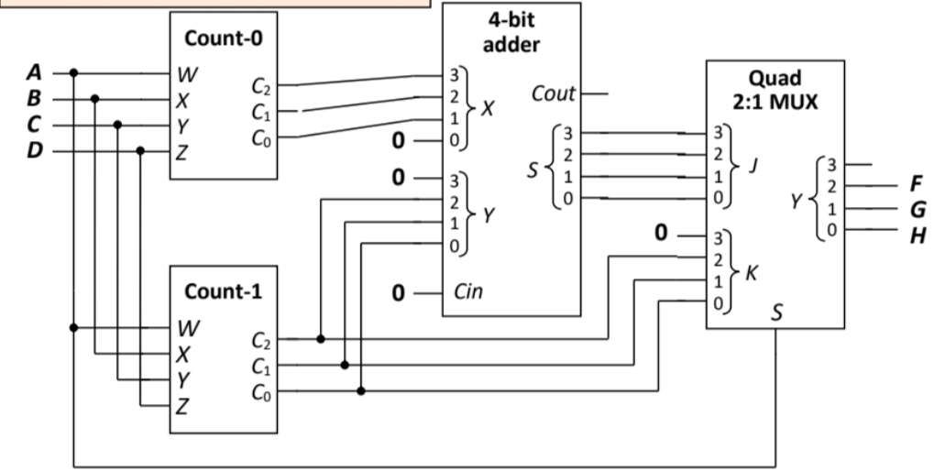
Ideas:
If A=1 (or D=0), count #1s in ABCD.
If A=0 (or D=1), #1s + 2 × #0s.
Q3.
A | B | C | D | F | G | H
0 | 0 | 0 | 0 | 0 | 0 | 0
1 | 0 | 0 | 0 | 0 | 0 | 1
1 | 1 | 0 | 0 | 0 | 1 | 0
1 | 1 | 1 | 0 | 0 | 1 | 1
1 | 1 | 1 | 1 | 1 | 0 | 0
0 | 1 | 1 | 1 | 1 | 0 | 1
0 | 0 | 1 | 1 | 1 | 1 | 0
0 | 0 | 0 | 1 | 1 | 1 | 1

Slide 10
A | B | C | D | F | G | H
0 | 0 | 0 | 0 | 0 | 0 | 0
1 | 0 | 0 | 0 | 0 | 0 | 1
1 | 1 | 0 | 0 | 0 | 1 | 0
1 | 1 | 1 | 0 | 0 | 1 | 1
1 | 1 | 1 | 1 | 1 | 0 | 0
0 | 1 | 1 | 1 | 1 | 0 | 1
0 | 0 | 1 | 1 | 1 | 1 | 0
0 | 0 | 0 | 1 | 1 | 1 | 1
Ideas:
If A=1 (or D=0), count #1s in ABCD.
If A=0 (or D=1), 4 + #0s.
Q3.
Cin
4-bit
// adder
X₃
X₂
X₁
X₀
Cin
Cout
Quad
2:1 MUX
Cin
S₃
S₂
S₁
S₀
J₃
J₂
J₁
J₀
Count-0
W
X
Y
Z
C₂
C₁
C₀
Y₃
Y₂
Y₁
Y₀
Y₃
Y₂
Y₁
Y₀
K₃
K₂
K₁
K₀
Cin
Cin
Count-1
W
X
Y
Z
C₂
C₁
C₀
S

Slide 11
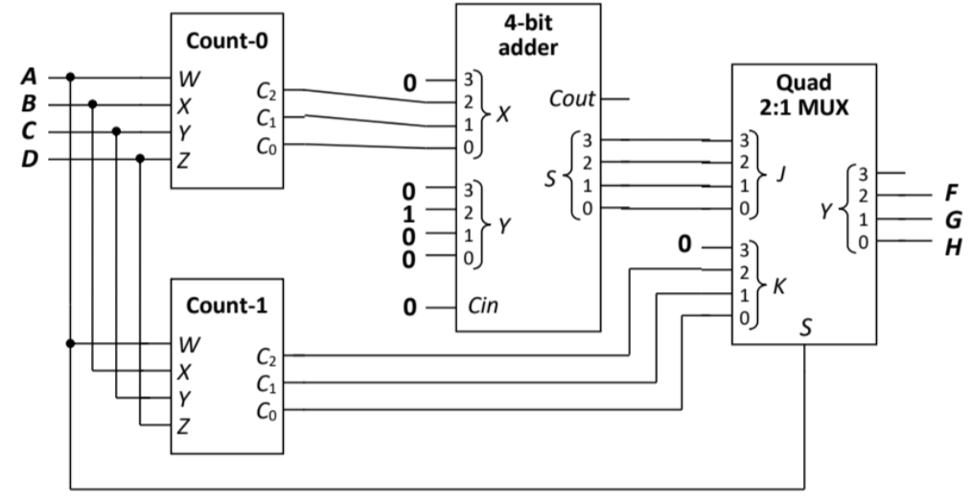
Ideas:
If A=1 (or D=0), count #1s in ABCD.
If A=0 (or D=1), 4 + #0s.
Q3.
A | B | C | D | F | G | H
0 | 0 | 0 | 0 | 0 | 0 | 0
1 | 0 | 0 | 0 | 0 | 0 | 1
1 | 1 | 0 | 0 | 0 | 1 | 0
1 | 1 | 1 | 0 | 0 | 1 | 1
1 | 1 | 1 | 1 | 1 | 0 | 0
0 | 1 | 1 | 1 | 1 | 0 | 1
0 | 0 | 1 | 1 | 1 | 1 | 0
0 | 0 | 0 | 1 | 1 | 1 | 1

Slide 12
Q4.
F(A,B,C,D) = Σ m(0,1,3,4,6,7,8,9,11,12,14,15)
F
C
1 | 1 | 1 | 0
1 | 0 | 1 | 1
1 | 0 | 1 | 1
1 | 1 | 1 | 0
F = C'∙D' + C∙D + …
B
A
Too long!
D

Slide 13
Q4.
F(A,B,C,D) = Σ m(0,1,3,4,6,7,8,9,11,12,14,15)
Let’s implement F’ instead and then invert it!
F
C
F' = B∙C'∙D + B'∙C∙D'
1 | 1 | 1 | 0
1 | 0 | 1 | 1
1 | 0 | 1 | 1
1 | 1 | 1 | 0
B
A
D
F'
C
0 | 0 | 0 | 1
0 | 1 | 0 | 0
0 | 1 | 0 | 0
0 | 0 | 0 | 1
B
A
D

Slide 14
Q4.
F(A,B,C,D) = Σ m(0,1,3,4,6,7,8,9,11,12,14,15)
F' = B∙C'∙D + B'∙C∙D'
Cin
2×4
DEC
0
1
2
3
S₁
S₀
E
Cin
2×4
DEC
0
1
2
3
S₁
S₀
E

Slide 15
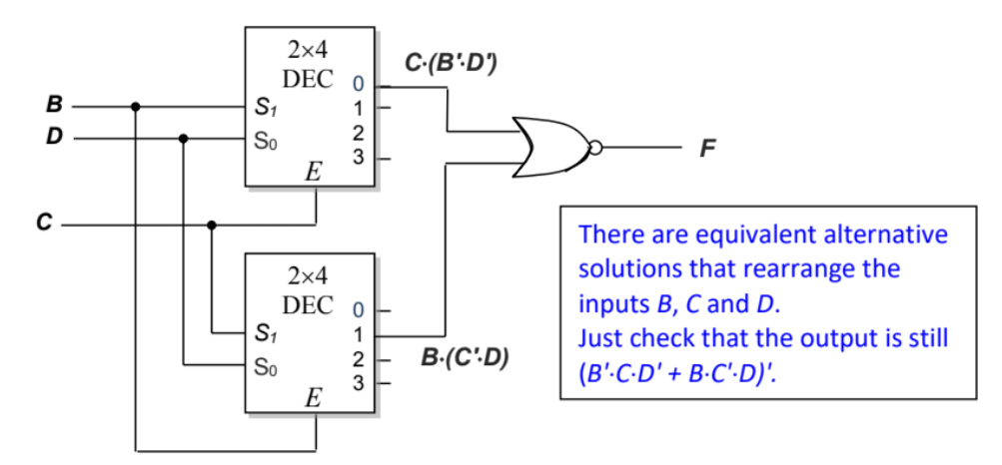
Q4.
F(A,B,C,D) = Σ m(0,1,3,4,6,7,8,9,11,12,14,15)
F' = B∙C'∙D + B'∙C∙D'

Slide 16
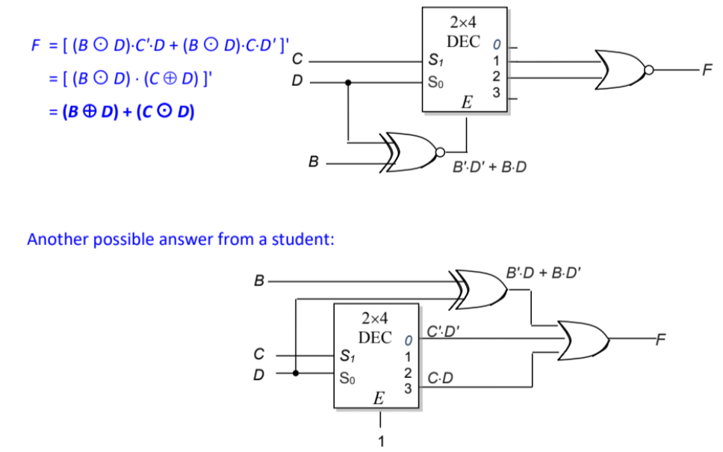
Q4.
F(A,B,C,D) = Σ m(0,1,3,4,6,7,8,9,11,12,14,15)
Even simpler circuit requiring only one decoder and two gates!

Slide 17
END OF FILE

Slide 18
Q1.
F(X,Y,Z) = Π M(1,5,6) ∙ D(4)
What if we change the selector lines to YZ?
X | Y | Z | F
0 | 0 | 0 | 1
0 | 0 | 1 | 0
0 | 1 | 0 | 1
0 | 1 | 1 | 1
1 | 0 | 0 | d
1 | 0 | 1 | 0
1 | 1 | 0 | 0
1 | 1 | 1 | 1
0
1
2
3
4:1
MUX
F
0
1
Z
Y

